Slide 1
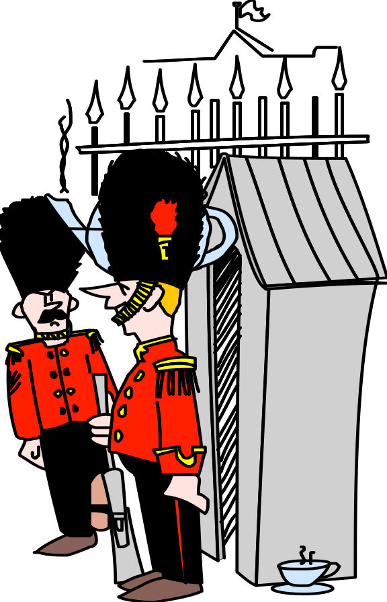

Chapter 5
Information Systems
Security
.

Slide 2
Presentation Outline
An Overview of Systems Security
Active Threats and Computer Networks
Controls for Active Threats
Passive Threats to Computer Networks
Disaster Risk Management

Slide 3

I. An Overview of Systems Security
Problems and Risks of Computerized Information Networks
Development of a Computer Security System
Analyzing Vulnerabilities and Threats

Slide 4
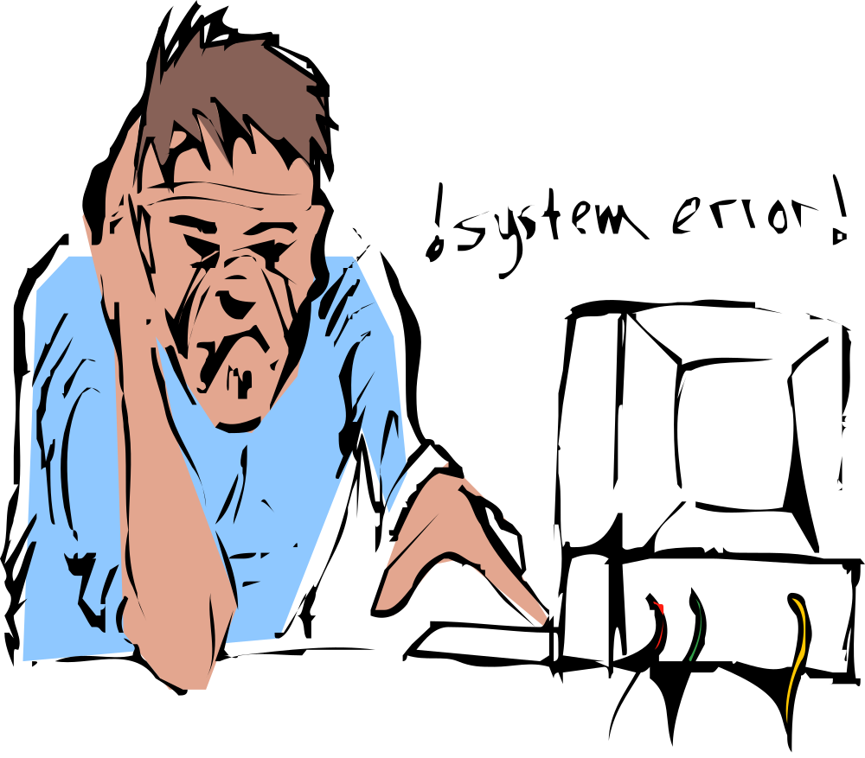
A. Problems and Risks of Computerized Information Networks
Business interruption
Loss of software
Loss of data
Loss of hardware
Loss of facilities
Loss of service and personnel

Slide 5
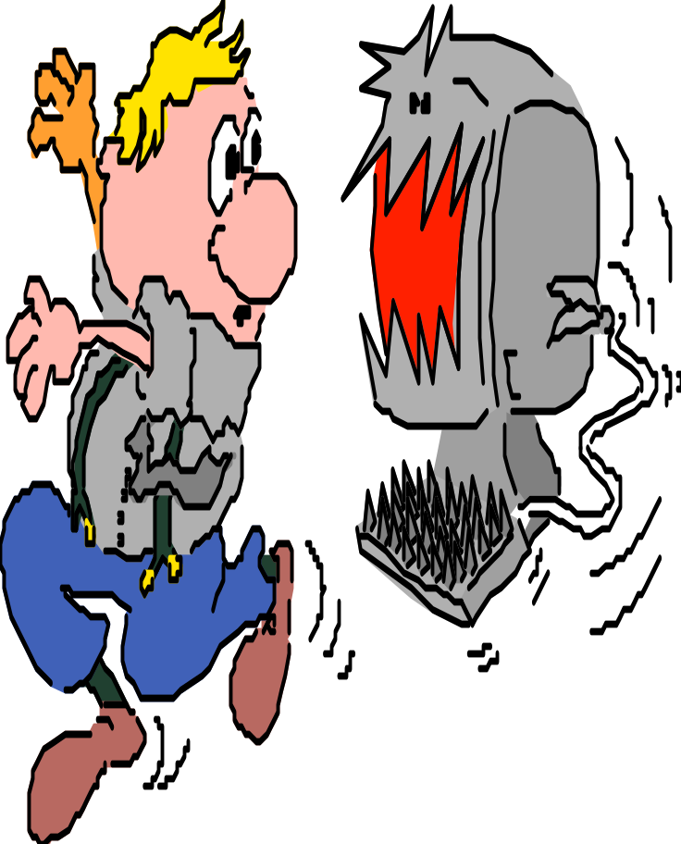
B. Development of a Computer Security System
As with the development of any information system, a computer security system requires the use of a life cycle approach.
Systems analysis
Systems design
Systems implementation
Systems operation, evaluation, and control

Slide 6

1. Systems Analysis
Analyze system vulnerabilities in terms of relevant threats and their associated loss exposures.
Loss of data.

Slide 7
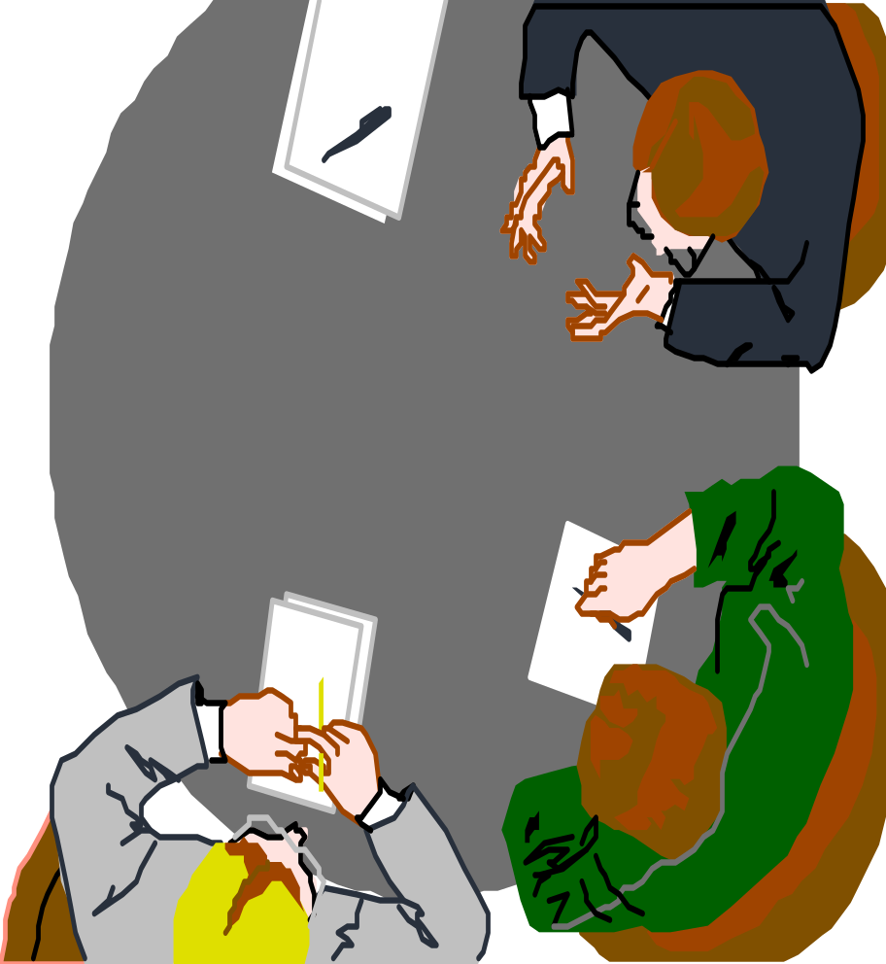
2. Systems Design
Design security measures and contingency plans to control the identified loss exposures.
Recovery Plan

Slide 8

3. Systems Implementation
Implement the security measures as designed.

Slide 9

4. Systems Operation, Evaluation, and Control
Operate the system and assess its effectiveness and efficiency. Make changes as circumstances require.

Slide 10
C. Analyzing Vulnerabilities and Threats
Quantitative Approach
Each loss exposure is computed as the product of the cost of an individual loss times the likelihood of its occurrence.
(See Figure 5.1 on p. 157)
Qualitative Approach
This approach simply lists out the system’s vulnerabilities and threats, subjectively ranking them in order of their contribution to the company’s total loss exposures.

Slide 11
II. Active Threats and Computer Networks
Active threats include information systems fraud and computer sabotage. Statistics have shown that corporate losses due to fraud and embezzlement exceed total losses due to bribery, burglary, and shoplifting by a wide margin.
The White-Collar Criminal
Computer Fraud and Abuse Act of 1986
Groups Posing a Potential Threat
Examples of Active Threats
The Control Environment

Slide 12
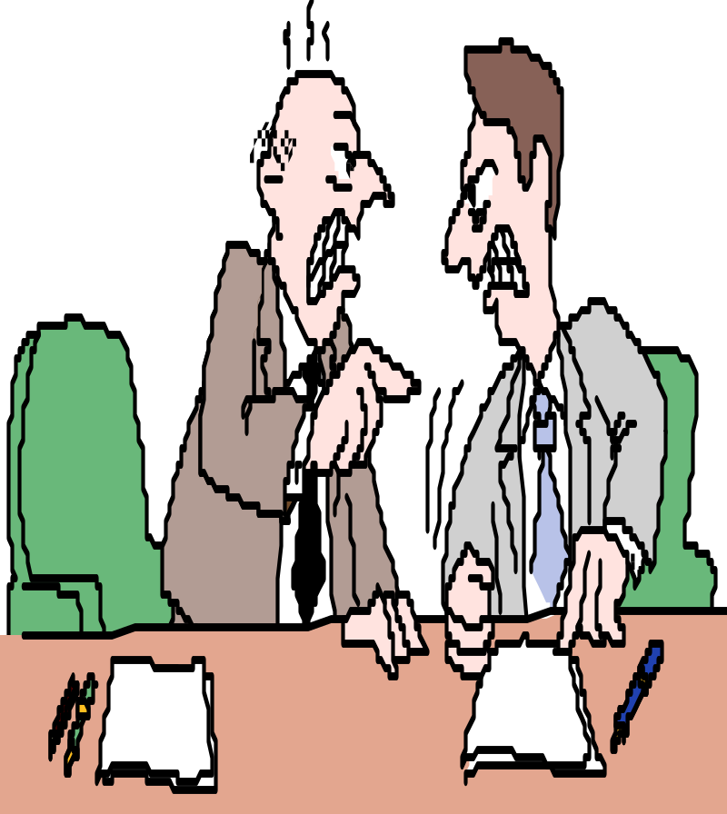
A. The White-Collar Criminal
You’re making a big mistake!
So it was you!
It is not possible to rigorously identify the white-collar criminal. Managers tend to shy away from public prosecution that would result in negative publicity.

Slide 13
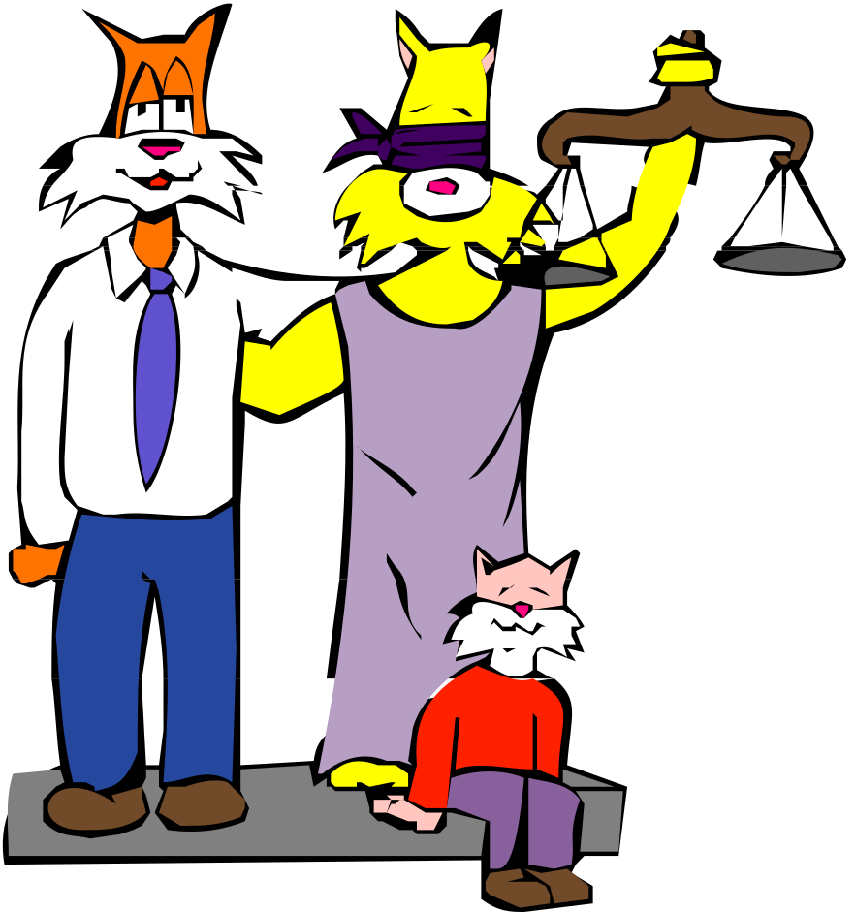
B. Computer Fraud and Abuse Act of 1986
It is a federal crime to knowingly and with intent fraudulently gain unauthorized access to data stored in the computers of financial institutions, computers owned or used by the federal government, or computers operating in interstate commerce.

Slide 14
C. Groups Posing a Potential Threat
Computer systems personnel include computer maintenance persons, programmers, operators, information systems administrative personnel, and data control clerks.
Users of the computer system are outside the functional area of data processing. They have access to sensitive data and may control important computer inputs.
Intruders who attach information systems for fun and challenge are known as hackers. Other intruders include unnoticed intruders, wiretappers, piggybackers, impersonating intruders, and eavesdroppers.

Slide 15
D. Examples of Active Threats
Input Manipulation
Program Alteration
Direct File Alteration
Data Theft
Sabotage
Misappropriation of Computer Resources

Slide 16

1. Input Manipulation
Manipulating input to intentionally achieve an incorrect result.
Misappropriate assets
Conceal an embezzlement
Note: Most frequently used method of computer fraud. May be
attributable to the fact that it requires the least amount of technical
skill.

Slide 17

2. Program Alteration
Program code is improperly manipulated to intentionally achieve a certain result. Programmers should not be allowed unauthorized access to programs.
Access
Denied
Note: Least frequently used method of computer fraud. May be
attributable to the fact that it requires technical skills that are only
possessed by a limited number of people.

Slide 18

3. Direct File Alteration
Transfer company funds to my personal account.
Inputting data into a computer system while bypassing the normal process.

Slide 19
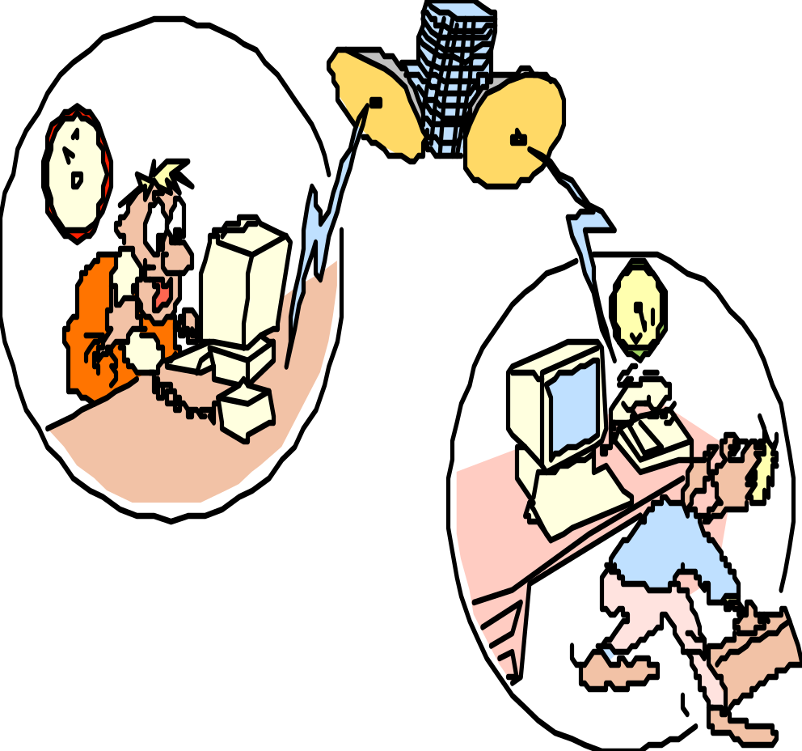
4. Data Theft
Data theft involves stealing a competitors information. For example, e-mail allows large amounts of information to be transmitted in a few minutes time.

Slide 20

5. Sabotage
Destroying some aspect of computer processing.
Logic bomb – Dormant piece of code activated by a specific later event.
Trojan horse = Destructive program masquerading as a legitimate one (See note below).
Worm – A virus that spreads over a computer network.
Note: A virus program is similar to a Trojan horse but can spread
itself to other programs, “infecting” them with the same virus.

Slide 21

6. Misappropriation of Computer Resources
One type of misappropriation of computer resources exists when employees use computer resources for their own business

Slide 22
E. The Control Environment
Since no security system is infallible, an atmosphere conducive to security must be created.
Accounting and computing functions should be separated.
The board of directors should appoint an audit committee who should approve the appointment of the internal audit director.
Budgets help control spending on equipment.
System security should be thoroughly test.
The duties of computer users and systems personnel should be separated.
Access privileges should be cancelled immediately when employees are fired.
There should be a well-documented internal policy against software piracy.

Slide 23
III. Controls for Active Threats
A layered approach can be used to separate perpetrators from their potential targets.
Site-access Controls
System-access Controls
File-access Controls

Slide 24

A. Site-access Controls
Site-access controls physically separate individuals from computer resources. Examples include:
Biometric hardware authentication
Isolated and hard to find locations
Restrictions on loading new software
Computer Room

Slide 25

B. System-access Controls
System-access controls authenticate users by means such as account numbers, passwords, firewalls, and encryption.
Password

Slide 26
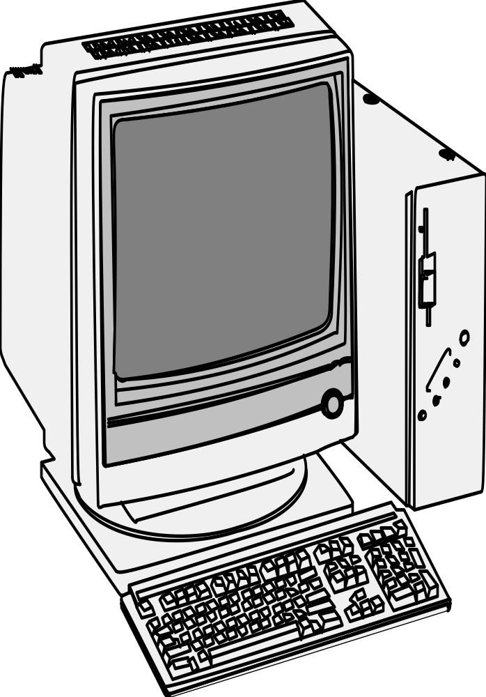

C. File-access Controls
File-access controls prevent unauthorized access to both data and program files. Programmers should not be permitted access to programs without written permission. In addition, all important programs should be kept in locked files so they can be run, but not looked at or altered. Programmers should only be allowed to change copies of active programs. Upon completion, these should be tested and approved before being used.
Locked file

Slide 27
IV. Passive Threats to Computer Networks
Passive threats include problems like power and hardware failures. Controls for passive threats include:
Fault-tolerant Systems
File Backups

Slide 28
A. Fault-tolerant Systems
If one part of the system fails, a redundant part immediately takes over with little or no interruption in operations. Fault-tolerance can be applied at five different levels:
Network communications (duplicate communication paths)
CPU processors (watchdog processor)
Direct-access storage devices or DASDs (disk mirroring or disk shadowing)
Power supply (battery backup)
Individual transactions (rollback processing & database shadowing)

Slide 29
B. File Backups
A prior version of data is used to recover lost data. Examples include:
Full backups – Backs up all files on a given disk. Archive bit set to zero during backup process.
Incremental backup – Backs up only those files that have been modified since the last full or incremental backup (files with archive bit set to one). Archive bit is set to zero after backup.
Differential backup – Incremental backup that does not set archive bits back to zero.

Slide 30
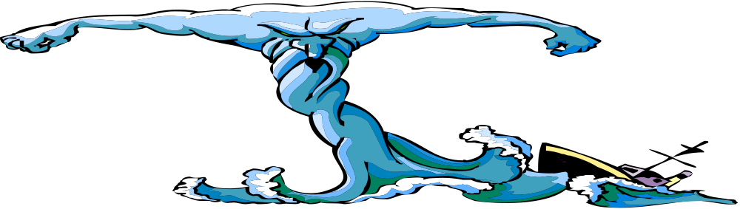
V. Disaster Risk Management
Preventing Disaster
Implementing a Disaster Recovery Plan
Alternate Processing Arrangements

Slide 31

A. Preventing Disaster
Concentrations of computer equipment should be located in areas least exposed to natural disaster and sabotage.
Studies have shown the following frequency of disaster causes:
  Natural disaster 30%
  Deliberate actions 45%
  Human error 25%

Slide 32
B. Implementing a Disaster Recovery Plan
Three steps of implementation include:
  Obtain senior management support and set up a planning committee.
  Plan should be thoroughly documented and approved by the planning committee.
  Include appropriate components in contingency plan.
Three components of contingency plan include:
  Assess the company’s critical needs regarding people, areas, equipment, records.
  List priorities of recovery – Meet critical needs first.
  Determine recovery strategies and procedures:
    What to do
    Who should do it
    How to do it
    How long it will take

Slide 33
C. Alternate Processing Arrangements
The most important part of a disaster recovery plan is the specification of a backup site. Alternatives include:
Purchased Alternatives
Contract Alternatives

Slide 34



1. Purchased Alternatives
Cold Site – Computing site with computer wiring but no equipment.
Hot Site – Computing site with both computer wiring and equipment.
Flying-start Site – Computing site with computer wiring, equipment, and a recent backup of data and software.

Slide 35
2. Contract Alternatives
Service Bureau – Provides data processing to companies who do not process their own data. Viable for small companies with simple data processing.
Commercial Vendor of Disaster Service – Leases hot sites for a monthly fee.
Shared Contingency or Reciprocal Disaster Agreement – Two companies agree to help each other if the need arises. May involve joint ownership of a common hot site.

Slide 36
Summary
Environment – Risks, system development, white collar criminal, audit committee.
Layered approach for active threats: site-access, system-access, and file-access controls
Fault-tolerant systems and backups
Purchased processing – cold, hot, flying start
Contract processing – service bureau, commercial vendor, shared contingency agreement.

